Slide 1


Interpretable Machine Learning
Using LIME Framework
kasia.kulma@aviva.com
@KKulma
Kasia Kulma (PhD), Data Scientist

Slide 2
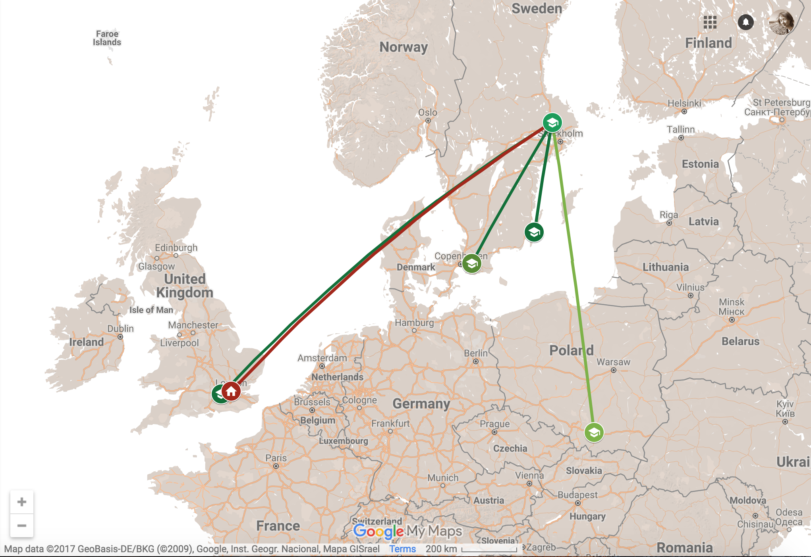
About myself...

Slide 3




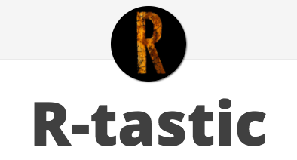
Data
https://kkulma.github.io

Slide 4
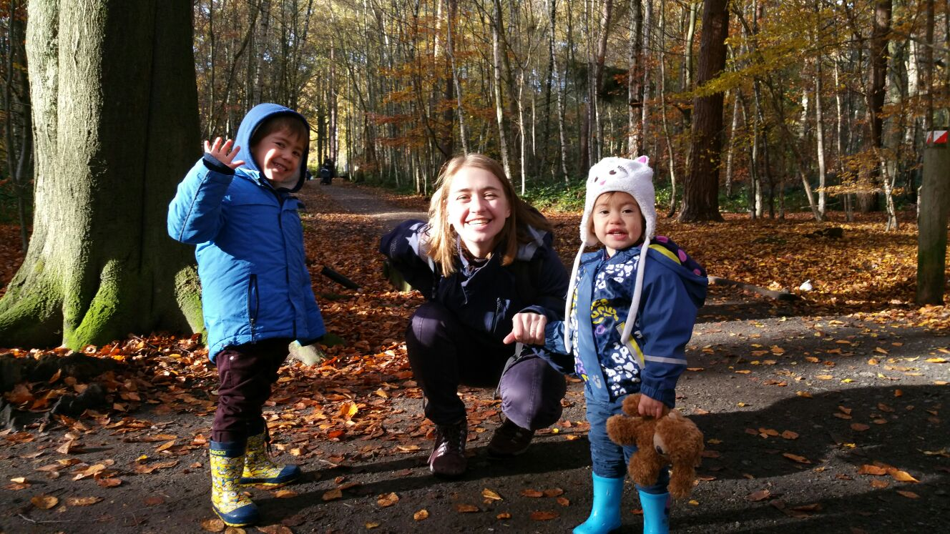
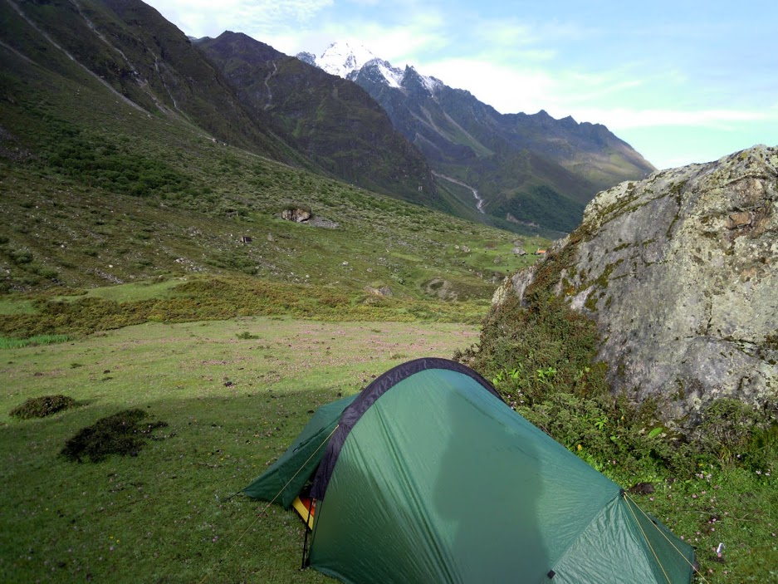
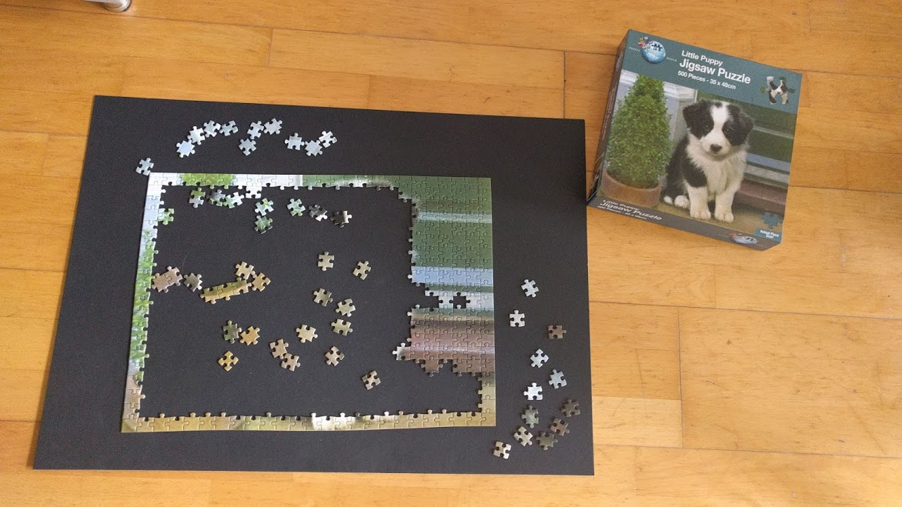
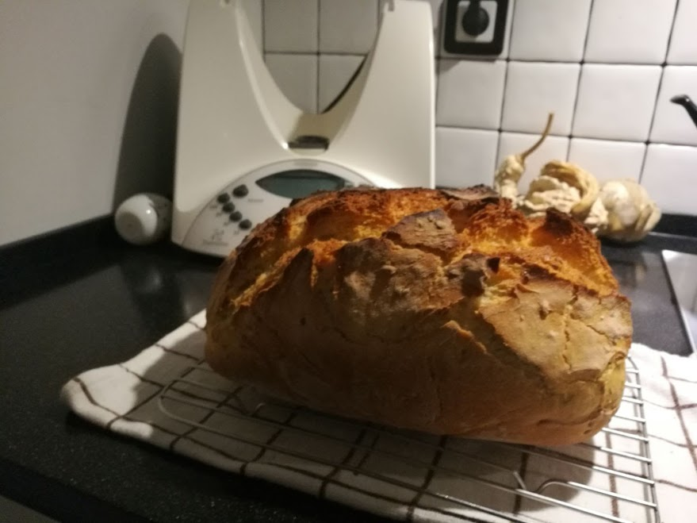
Data
Non-Data
https://kkulma.github.io

Slide 5
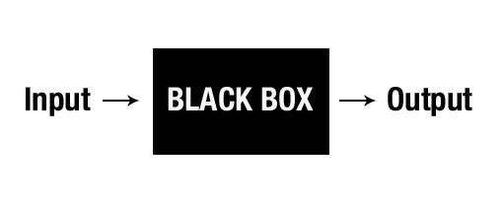
System that performs behaviour but you don’t know how it works

Slide 6
Will the loan default?

Slide 7
Will the loan default?
Is it a cancer cell? Will this prisoner commit a crime? Will this machine break down?

Slide 8

Will the loan default?
X2
Income
Savings
X1
Source: https://www.youtube.com/watch?v=LAm4QmVaf0E&t=3658s

Slide 9





Get Historical Data
X2
Income
Savings
X1
Source: https://www.youtube.com/watch?v=LAm4QmVaf0E&t=3658s

Slide 10





Linear Classifiers
YOU CAN INTERPRET IT!
X2
IF 10X1 + X2 - 5 > 0
OTHERWISE
Income
Savings
X1
Source: https://www.youtube.com/watch?v=LAm4QmVaf0E&t=3658s

Slide 11

Decision trees
X2
YOU CAN STILL INTERPRET IT!
X1 > 0.5
X2 > 0.5
X1
Source: https://www.youtube.com/watch?v=LAm4QmVaf0E&t=3658s

Slide 12
Big Data: More Complexity & More Dimensions
X2
X1

Slide 13
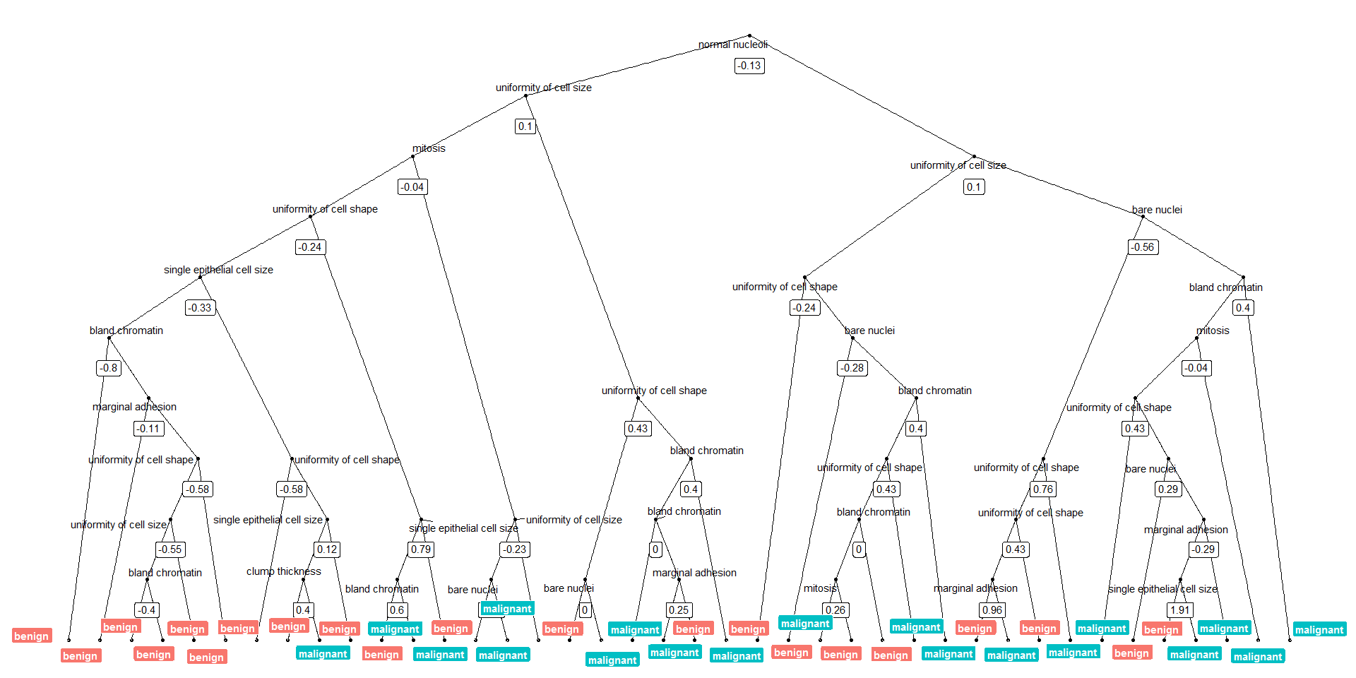
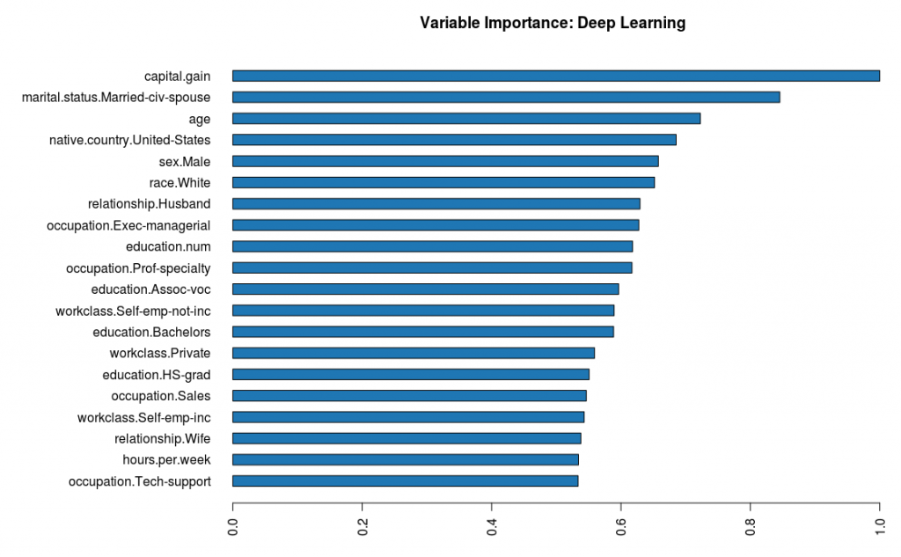
Big Data: More Complexity & More Dimensions
X2
X1

Slide 14
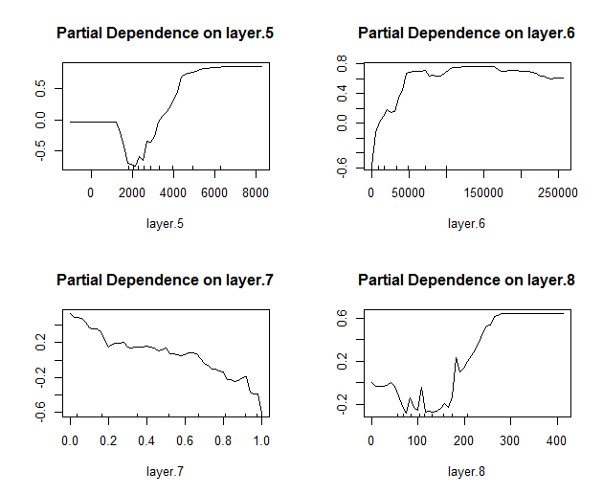
Big Data: More Complexity & More Dimensions
X2
X1

Slide 15
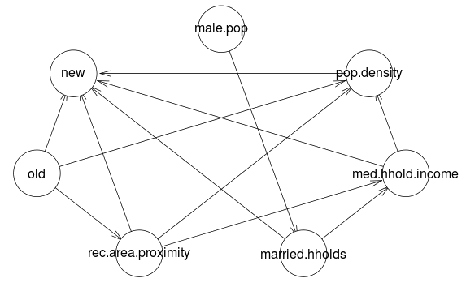
Big Data: More Complexity & More Dimensions
X2
X1

Slide 16


Accuracy VS Interpretability
Accuracy
Interpretability
Source: https://www.youtube.com/watch?v=LAm4QmVaf0E&t=3658s

Slide 17
Accuracy VS Interpretability
?
Accuracy
Interpretability
Source: https://www.youtube.com/watch?v=LAm4QmVaf0E&t=3658s

Slide 18

Local
Interpretable
Model-agnostic
Explanations

Slide 19
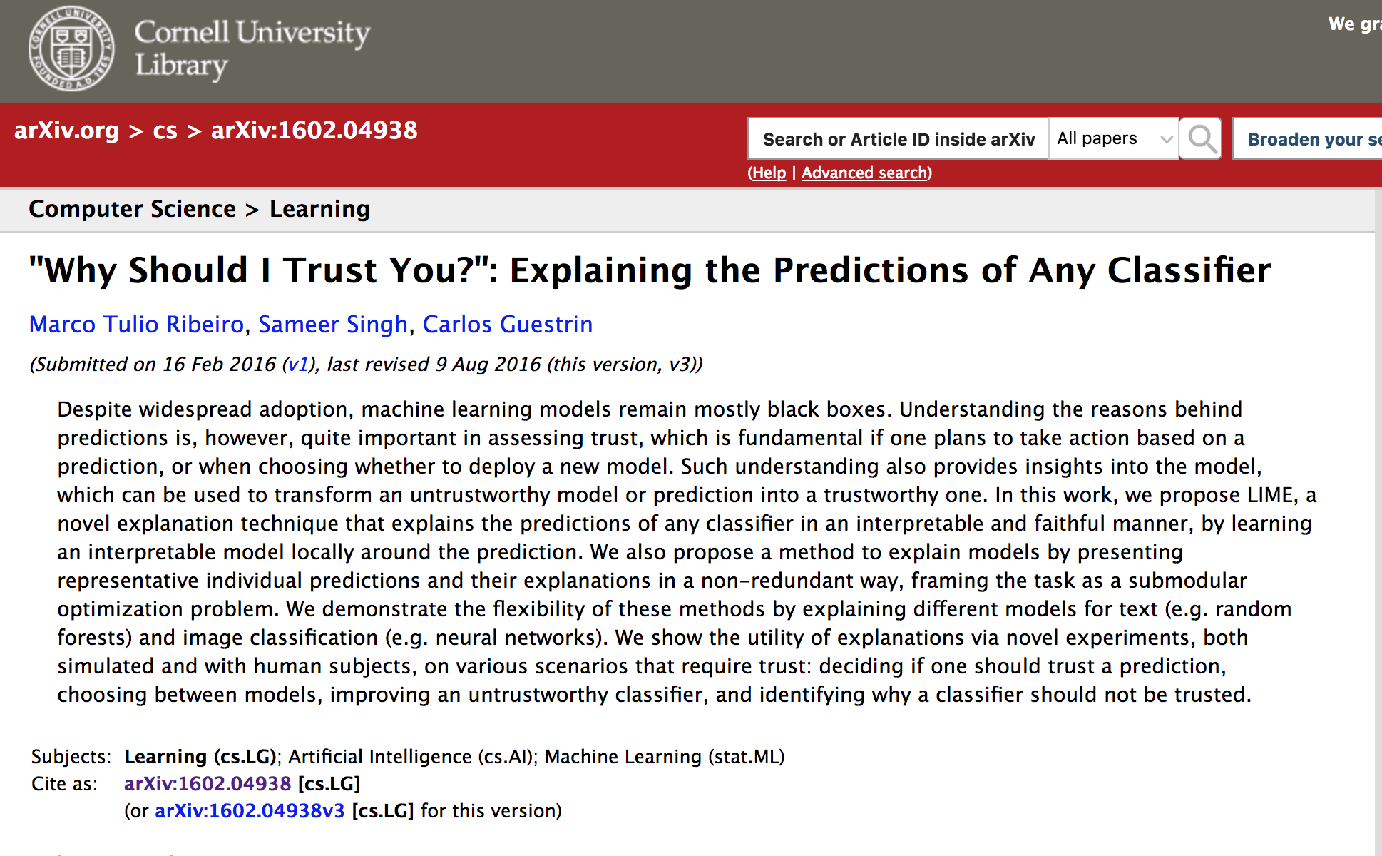
Local
Interpretable
Model-agnostic
Explanations

Slide 20


Local
Interpretable
Model-agnostic
Explanations

Slide 21
Being Local and Model-Agnostic…
Source: https://www.youtube.com/watch?v=LAm4QmVaf0E&t=3658s

Slide 22
Being Local and Model-Agnostic…
Source: https://www.youtube.com/watch?v=LAm4QmVaf0E&t=3658s

Slide 23
Being Local and Model-Agnostic…
Explanation is an interpretable model,
that is locally accurate
Source: https://www.youtube.com/watch?v=LAm4QmVaf0E&t=3658s

Slide 24
HOW LIME WORKS
Permute data*
2. Calculate distance between permutations and original observations*
3. Make predictions on new data using complex model
4. Pick m features best describing the complex model outcome from the permuted data.*
5. Fit a simple model to the permuted data with m features and similarity scores as weights *
6. Feature weights from the simple model make explanations for the complex models local behaviour

Slide 25
HOW LIME WORKS
Permute data*
2. Calculate distance between permutations and original observations*
3. Make predictions on new data using complex model
4. Pick m features best describing the complex model outcome from the permuted data.*
5. Fit a simple model to the permuted data with m features and similarity scores as weights *
6. Feature weights from the simple model make explanations for the complex models local behaviour

Slide 26
HOW LIME WORKS
Permute data*
2. Calculate distance between permutations and original observations*
3. Make predictions on new data using complex model
4. Pick m features best describing the complex model outcome from the permuted data.*
5. Fit a simple model to the permuted data with m features and similarity scores as weights *
6. Feature weights from the simple model make explanations for the complex models local behaviour

Slide 27
HOW LIME WORKS
Permute data*
2. Calculate distance between permutations and original observations*
3. Make predictions on new data using complex model
4. Pick m features best describing the complex model outcome from the permuted data.*
5. Fit a simple model to the permuted data with m features and similarity scores as weights *
6. Feature weights from the simple model make explanations for the complex models local behaviour

Slide 28
HOW LIME WORKS
Permute data*
2. Calculate distance between permutations and original observations*
3. Make predictions on new data using complex model
4. Pick m features best describing the complex model outcome from the permuted data.*
5. Fit a simple model to the permuted data with m features and similarity scores as weights *
6. Feature weights from the simple model make explanations for the complex models local behaviour

Slide 29
HOW LIME WORKS
Permute data*
2. Calculate distance between permutations and original observations*
3. Make predictions on new data using complex model
4. Pick m features best describing the complex model outcome from the permuted data.*
5. Fit a simple model to the permuted data with m features and similarity scores as weights *
6. Feature weights from the simple model make explanations for the complex models local behaviour

Slide 30
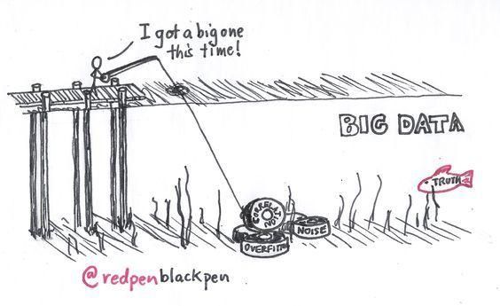
CAN YOU BUILD YOUR TRUST BASED ON ACCURACY?

Slide 31
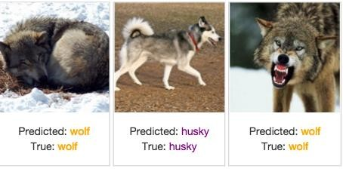
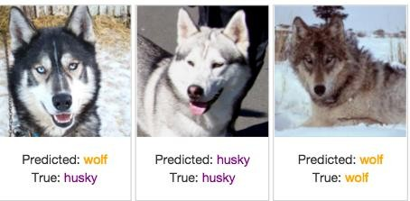
CAN YOU BUILD YOUR TRUST BASED ON ACCURACY?
Only 1 mistake!

Slide 32
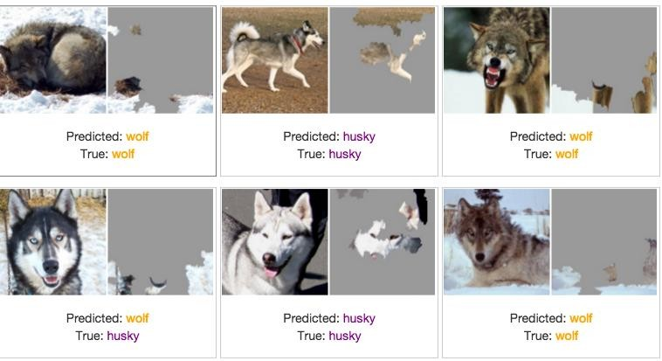
… YES, IF YOU WANT TO BUILD A GREAT SNOW DETECTOR!

Slide 33
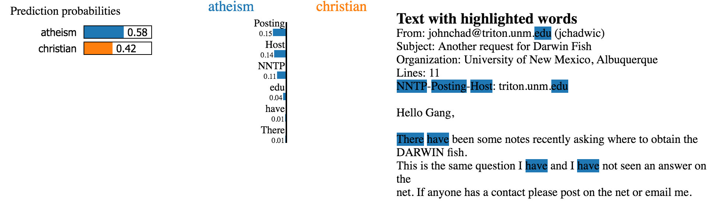
LIME IN TEXT ANALYTICS

Slide 34
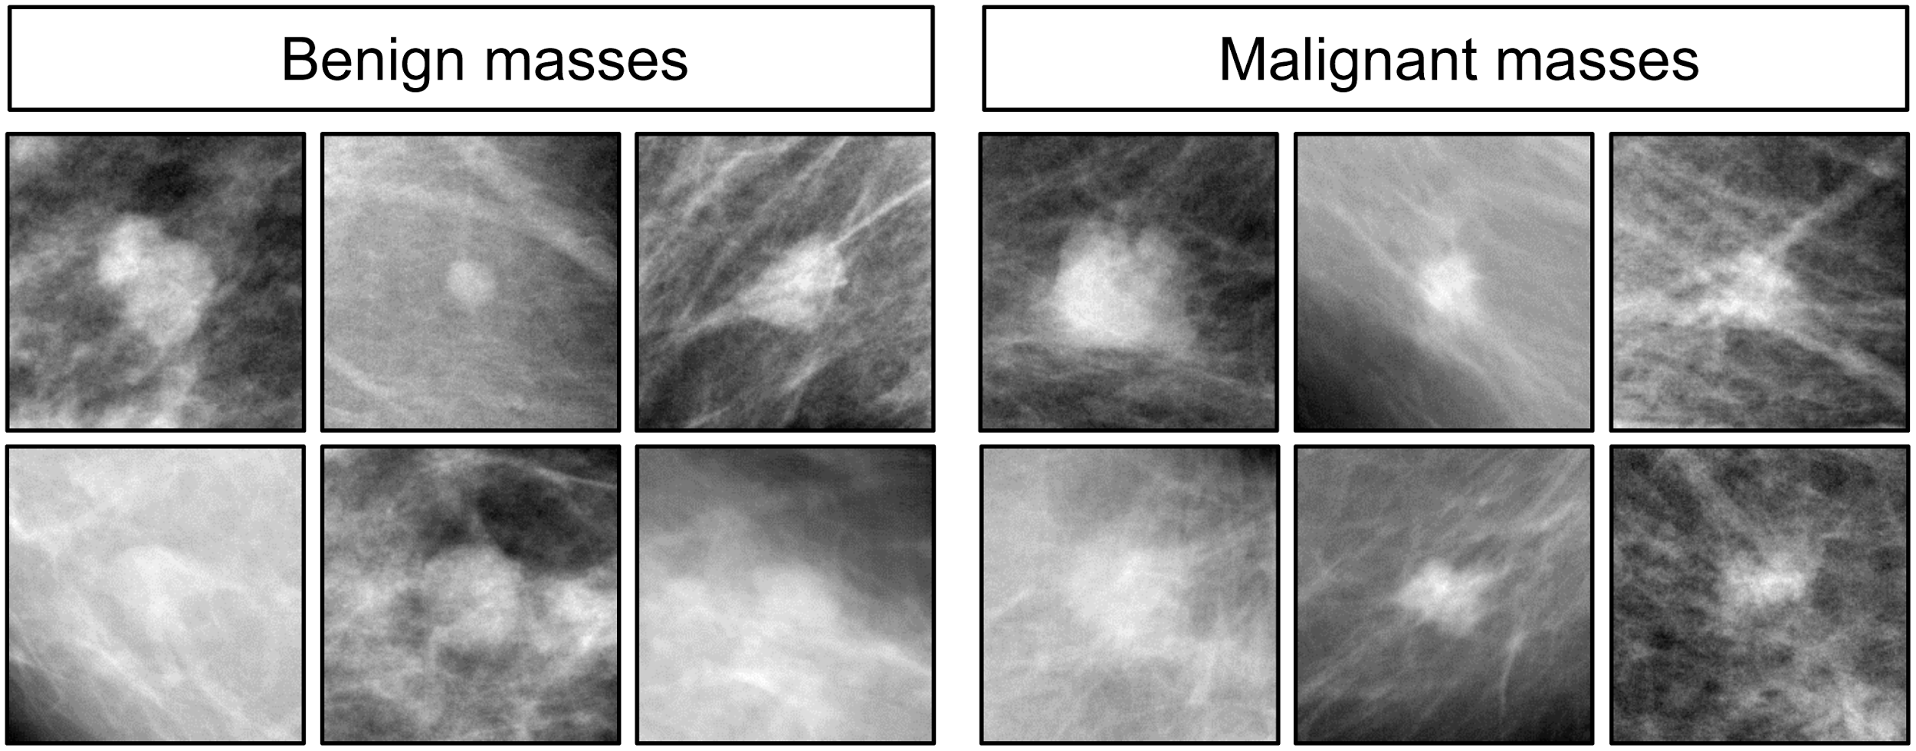
UNDERSTANDING CLASSIFICATION OF BENIGN AND MALIGNANT BREAST CANCER CELLS
LET’S SEE SOME CODE

Slide 35



WHY IS IT IMPORTANT?
Trust
Predict
Improve
How can we trust the predictions are correct?
How can we understand and predict the behavior?
How do we improve it to prevent potential mistakes?

Slide 36
WHY IS IT IMPORTANT?
Trust
Predict
Improve
How can we trust the predictions are correct?
How can we understand and predict the behavior?
How do we improve it to prevent potential mistakes?
Being able to interpret the explanations and compare classifiers based on them
Improved prediction of model behavior and time to make that assessment when explanations were provided
Non-ML experts with explanations
VS
ML experts without explanations

Slide 37
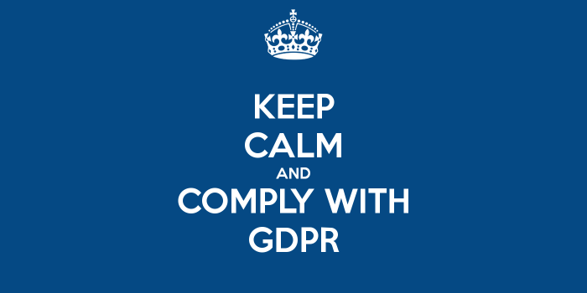

Slide 38
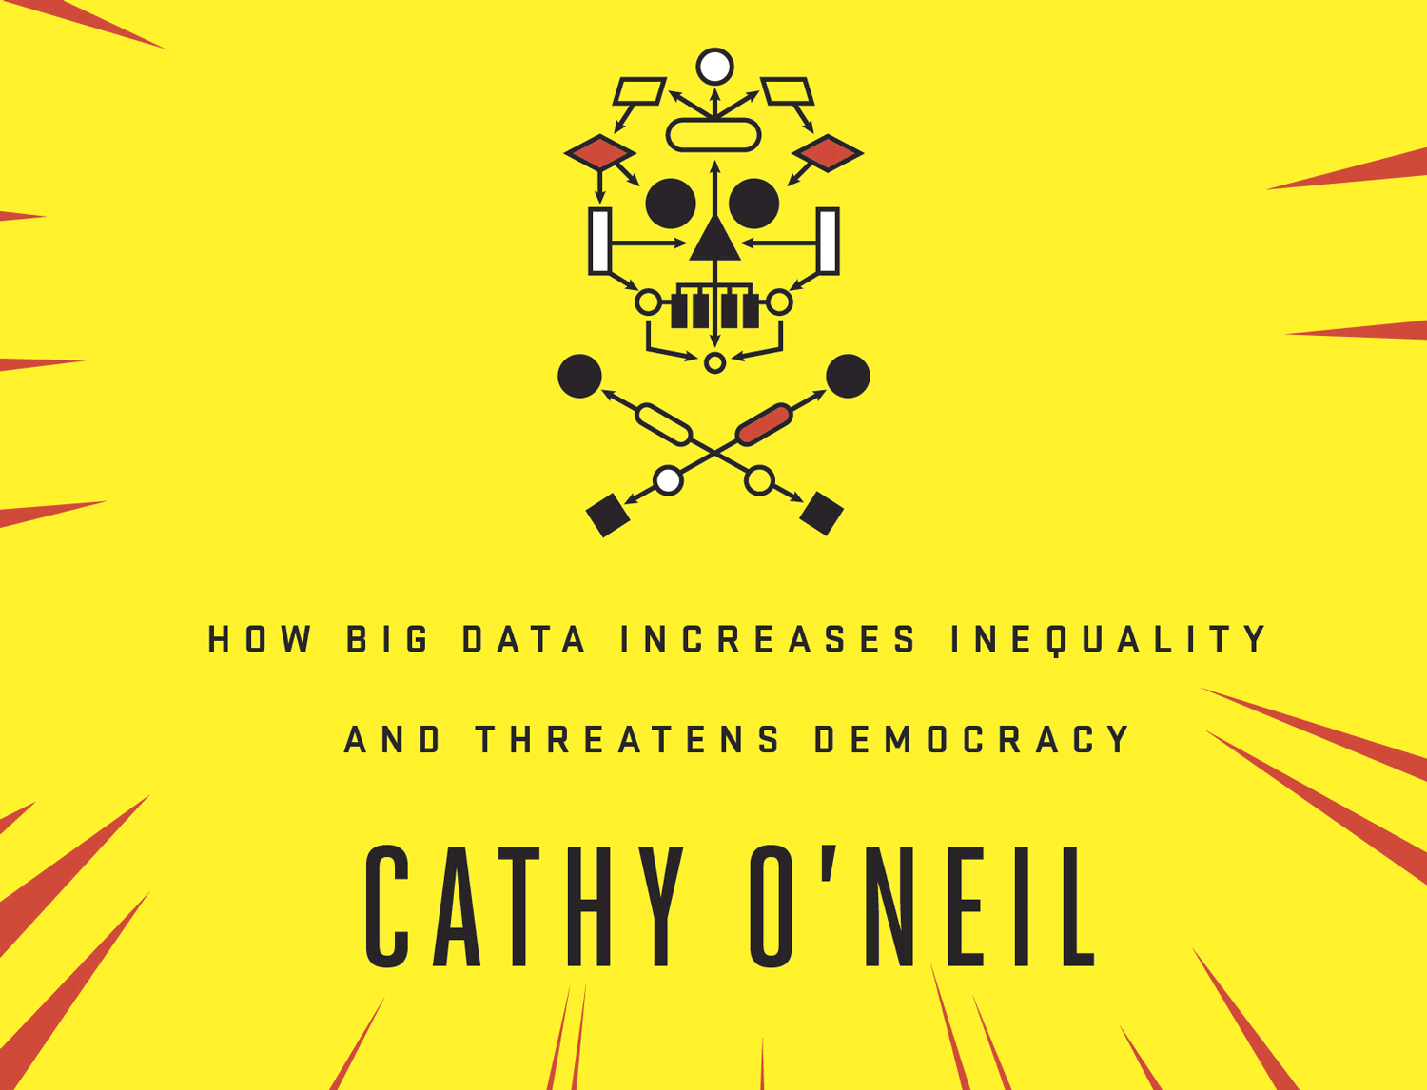

Slide 39
